Slide 1
Azure Data Meeting Notes

Slide 2
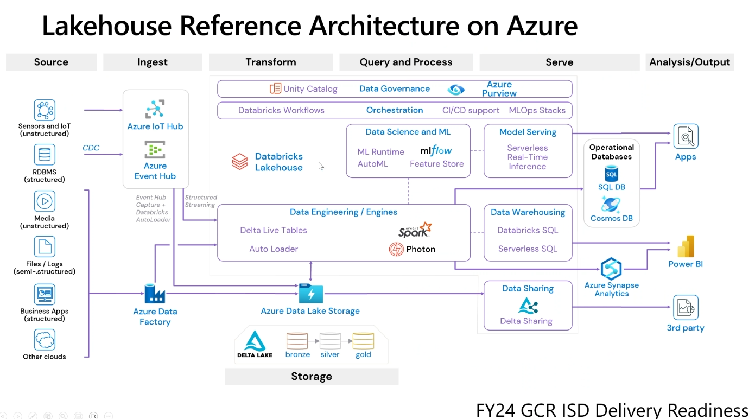

Slide 3
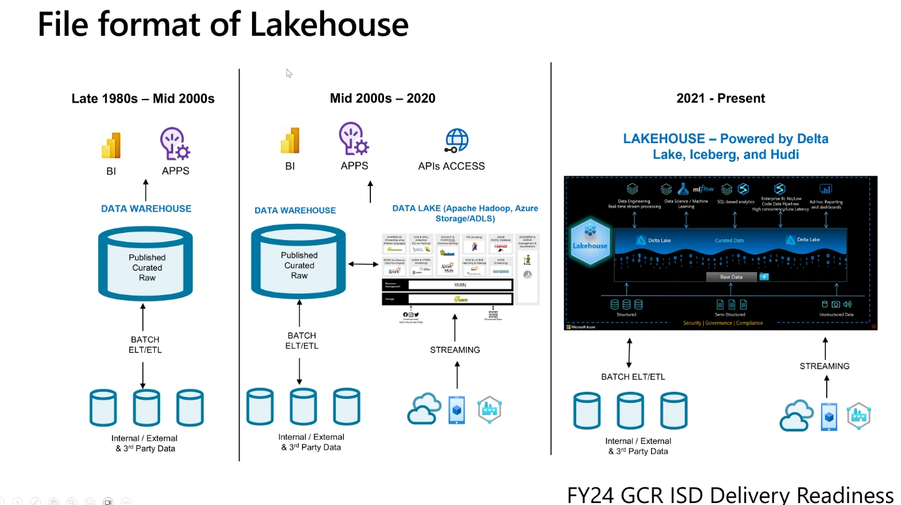

Slide 4
